Slide 1
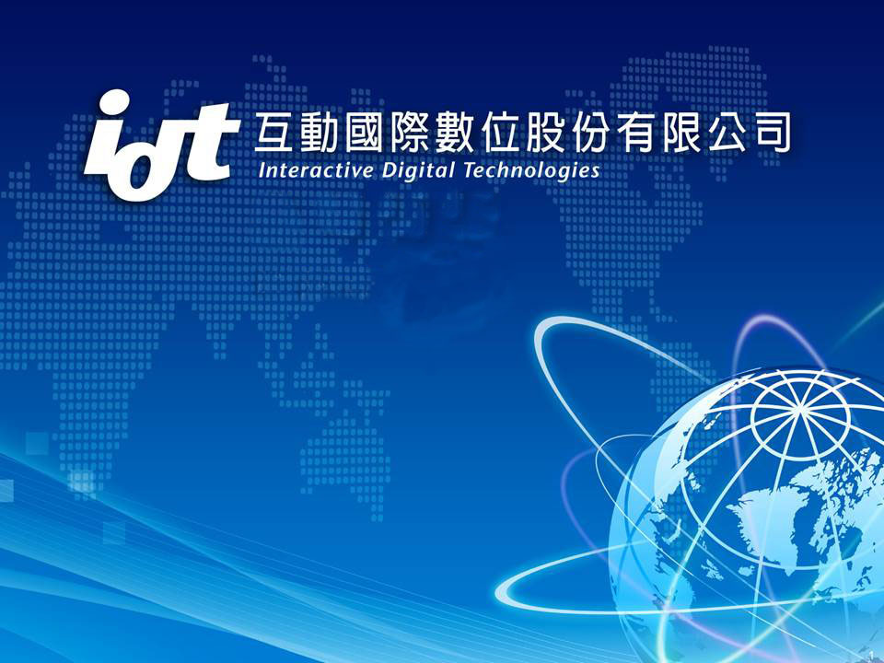
Investor Conference
Stock Code： 6486
Bond Code： 64861

Slide 2
Agenda
Financial Results
Industry and Operation
Overview
Development Plan

Slide 3
Disclaimer
This presentation may contain forward-looking based on current assumption and forecasts made by IDT management. Various known and unknown risk, uncertainties and other factors could lead to material differences between the actual future result, financial situation, development or performance of the company and the estimates given here.

Slide 4
FINANCIAL RESULTS

Slide 5
2017Y～2019Y Revenue
$1,795,556
$1,727,270
$1,387,432

Slide 6
Statements of Comprehensive Income
Selected Items (In NT$ thousands) | 2019Y3Q | 2019Y2Q | 2018Y3Q | 3Q19 over 2Q19 | 3Q19 over 3Q18
Operating Revenue | 1,387,432 | 954,317 | 1,073,579 | 45.38% | 29.23%
Gross Profit | 585,604 | 399,502 | 485,408 | 46.58% | 20.64%
Operating Expenses | 367,361 | 246,942 | 352,087 | 48.76% | 4.34%
Net Operating Income | 218,243 | 152,560 | 133,321 | 43.05% | 63.70%
Non-Operating income & Expense | 9,130 | 6,228 | 18,936 | 46.60% | -51.78%
Net Income | 186,855 | 129,538 | 125,082 | 44.25% | 49.39%
EPS(NT Dollar) | 5.06 | 3.51 | 2.85 | 44.16% | 77.54%
Financial Indicator：
Gross Margin | 42.21% | 41.86% | 45.21% | +0.35ppts | -3.00ppts
Net Profit Margin | 13.47% | 13.57% | 11.65% | -0.1ppts | +1.82ppts
ROE | 18.56% | 13.24% | 12.67% | +5.32ppts | +5.89ppts

Slide 7
Balance Sheets & Key Indices
Selected Items (In NT$ thousands) | 3Q19 |  | 2Q19 |  | 3Q18
 | Amount | % | Amount | % | Amoung | %
Cash & Cash equivalents | 697,920 | 35.61 | 718,417 | 33.85 | 385,194 | 19.11
Accounts Receivable | 314,766 | 16.06 | 393,462 | 18.54 | 300,704 | 14.92
Inventories | 249,217 | 12.71 | 291,960 | 13.76 | 495,314 | 24.58
prepayments | 254,778 | 13.00 | 261,135 | 12.30 | 368,737 | 18.30
Net PP&E | 251,664 | 12.84 | 251,234 | 11.84 | 252,666 | 12.54
Other current & non- current assets | 191,802 | 9.78 | 206,365 | 9.71 | 212,745 | 10.55
Total Assets | 1,960,147 | 100.00 | 2,122,573 | 100.00 | 2,015,360 | 100.00
Current Liabilities | 881,819 | 44.99 | 1,112,707 | 52.42 | 1,026,914 | 50.95
Non-current Liabilities | 66,557 | 3.38 | 55,412 | 2.61 | 58,872 | 2.93
Total Liabilities | 948,376 | 48.37 | 1,168,119 | 55.03 | 1,085,786 | 53.88
Total Shareholders’Equity | 1,011,771 | 51.63 | 954,454 | 44.97 | 929,574 | 46.12
Key Indices
A/R Turnover Days | 73.77 |  | 63.38 |  | 83.33
Inventory Turnover Days | 98.90 |  | 91.84 |  | 209.30
Current Ratio | 178.37 |  | 156.42 |  | 159.12

Slide 8
Cash Flows
(In NT$ Thousands) | 3Q19 | 2Q19 | 3Q18
Beginning Balance | 492,015 | 492,015 | 721,933
Cash from operating activities | 354,975 | 210,571 | (90,283)
Cash from investing activities | 35,007 | 20,090 | (6,316)
Cash dividends | (177,332) | 0 | (147,776)
Cash from financing activities | (6,745) | (4,259) | (92,364)
Ending Balance | 697,920 | 718,417 | 385,194

Slide 9
INDUSTRY AND OPERATION OVERVIEW

Slide 10
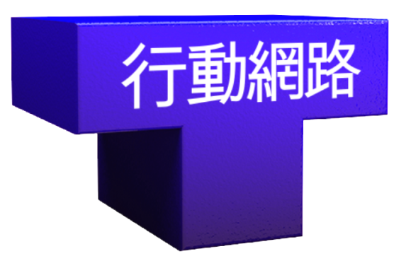
IDT 5 Core Business
Diversified System Integration
Base Station Implementation & Optimization
MOBILE NETWORK
IT & Cloud Service Innovation
Brand New Media Environment
Understanding Our World

Slide 11
Industry positioning
End User
Telecom operator
Media and TV
Industry
Market
Demander
Large Private
Enterprises
Academic and
Research
Institutions
Downstream System Integrator
System Supplier
Midstream Hardware and Software Dealers
Upstream Hardware and Software Manufacturers

Slide 12
DEVELOPMENTPLAN

Slide 13
Core Business In the Future
Department | Market | Solution and Product
Mobile Network | IoT ultra high speed wireless and 5G procurement will increase in the next 3 years. | 5G Base Station Implementation Mobile Network Optimization 5G Co-site Base Station…….
Media | UHD will be upgraded in broadcasters, cable operators and CHT MOD….. | 4K / UHD / Baseband over IP OTT applications AI in Media industry
IT & Cloud | For AI and IoT requirement, demand on cloud management and optimization, big data collection and analysis is increasing. | IT & cloud security solutions Integration of AI and IOT(integrates with Telcom 5G) SD-WAN enterprise …….
GIS | Spatio-temporal big data analytics in GIS integrated application | 3D GIS (GIS+BIM, 5G Site Analysis) DL / ML in GIS Spatial Big Data Science and Decision Support
Telecom and Broadband | Strong demand on high-speed optical backbone in 5G era. Large telecom operators in Taiwan all supplied equipments by IDT. | IP Transport / SDN / NFV/ Telecom Cloud/ AIoT / Big Data Analytics/ OSS/BSS 5G Transport /OTN / ROADM Optical Network ePRTC/PRTC Sync network Integration of fixed network NGN / IMS and wireless network VoLTE multimedia DOCSIS 3.1 CMTS /RPHY/CIN

Slide 14
Strong Demand on high-speed optical backbone requiremented in 5G era
The challenges of 5G are:
- ultra-high-speed communication speed,
high deployment density,
high mobile speed,
low latency,
connection of a large number of devices,
consistent user experience (QoE),
green energy.
3G/4G backbone speed requirement around 100Gbps
5G backbone speed requirement around
400 – 500 Gbps

Slide 15
Big Data Analytics
Accordint to the massive and high-speed connections generated by 5G, operators considering the requirement of users and networks
It can provide operators for users and networks:
Effective Network Management
User Behavior Analysis
Network traffic monitoring
Predictable maintenance
Reduce service risk
Notes:
Key Technology and Business Drivers:
- Mobile Cloud/Edge Computing
- IoT over 5G (Industrial IoT)
- Data Monetization
- Predictive Maintenance
Cognitive Analytics
關鍵技術和業務推動力： 移動雲/邊緣計算 IoT over 5G（工業IoT） 數據貨幣化 預測性維護 認知分析

Slide 16
eSIM AIoT Application
Authorities such as IDC, Gartner, McKinsey predict that by 2020,
The IoT devices will exceed 20 billion in global,
The overall IoT market size will exceed 3 trillion US dollars.
The M2M in IoT is the main market for eSIM.
The eSIM application in Taiwan M2M is increasing.
According to different user scenarios, the eSIM application is different, as shown below.
台灣雲協-物聯網esim技術與應用白皮書

Slide 17
Network Function Virtualization (NFV) and Software Defined Networking (SDN)
Entering the 5G era, telecom operators:
Can use virtualization technology in the 4G Evolved Packet Core (EPC),
Can use SDN and NFV to deconstruct and import the cloud to dispatch resources on demand,
The concept of flexible services creates a virtualized cloud-native network architecture, making it easier to manage the dispatch network.
IDT already has telecommunications cloud construction experience (NFV, SDN), which can seamlessly assist telecommunications providers or enterprises in their 5G network equipment virtualization requirements.

Slide 18
5G Enterprise Network
According to the NCC, 600MHz bandwidth is allocated in the mid-band from 4.4 GHz to 5.5 GHz. Among them, 200MHz bandwidth will be auctioned, and 300MHz will be used for police and public use.
IDT will work with Cisco to provide solution for enterprise private networks.

Slide 19
Cable/DOCSIS Evolution
IDT partner with Cisco to offer cable television network products for Kbro, TFN ,TBC, and CNS. Following the evolution of DOCSIS standard, IDT continues to leverage the cable broadband technology to provide solutions to cable TV operators.

Slide 20
Core Business In the Future
Department | Market | Solution and Product
Telecom and Broadband | Strong demand on high-speed optical backbone in 5G era. . ……… | IP Transport / SDN / NFV/ Telecom Cloud/ AIoT / Big Data Analytics/ OSS/BSS 5G Transport /OTN / ROADM …..
Media | UHD will be upgraded in broadcasters, cable operators and CHT MOD….. | 4K / UHD / Baseband over IP OTT applications AI in Media industry
IT & Cloud | For AI and IoT requirement, demand on cloud management and optimization, big data collection and analysis is increasing. | IT & cloud security solutions Integration of AI and IOT(integrates with Telcom 5G) SD-WAN enterprise…….
GIS | Spatio-temporal big data analytics in GIS integrated application | 3D GIS (GIS+BIM, 5G Site Analysis) DL / ML in GIS Spatial Big Data Science and Decision Support
Mobile Network | IoT ultra high speed wireless and 5G procurement will increase in the next 3 years. | 5G Base Station Implementation Mobile Network Optimization 5G Co-site Base Station Implementation (THSR/TRA/MRT/Major construction project)

Slide 21
Changing from 4G to 5G
5G spectrum
upgrade from 700MHz-2600MHz in 4G to 3.5/28GHz in 5G, changing the network characteristics and architecture:
Ultra High Speed Date Rates
Massive Connections
Low Latency
Due to the small coverage area, the number of base stations grow multiple quantity.

Slide 22
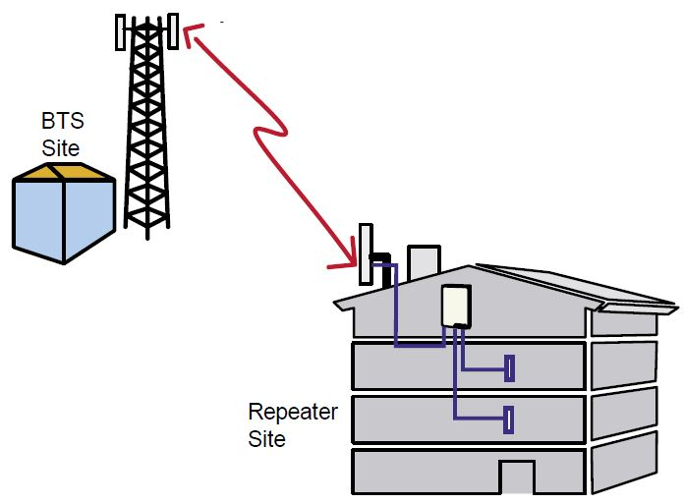
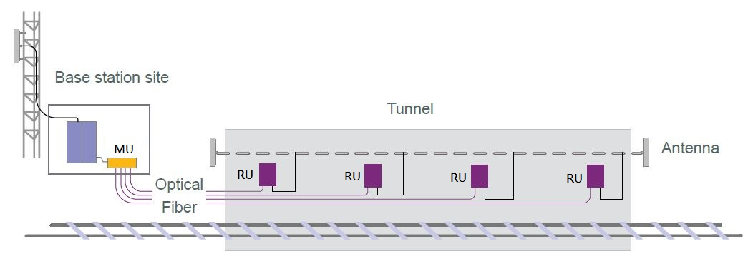
Mobile Network Scenarios
Indoor Coverage
Tunnel Coverage
Base Station
BTS site
BTS site
Tunnel
MU
Antenna
Optical Fiber
Repeater site

Slide 23
Core Business In the Future
Department | Market | Solution and Product
Telecom and Broadband | Strong demand on high-speed optical backbone in 5G era. ……… | IP Transport / SDN / NFV/ Telecom Cloud/ AIoT / Big Data Analytics/ OSS/BSS…………
Mobile Network | IoT ultra high speed wireless and 5G procurement will increase in the next 3 years. | 5G Base Station Implementation Mobile Network Optimization 5G Co-site Base Station ……
IT & Cloud | For AI and IoT requirement, demand on cloud management and optimization, big data collection and analysis is increasing. | IT & cloud security solutions Integration of AI and IOT(integrates with Telcom 5G) …….
GIS | Spatio-temporal big data analytics in GIS integrated application | 3D GIS (GIS+BIM, 5G Site Analysis) DL / ML in GIS Spatial Big Data Science and Decision Support
Media | UHD will be upgraded in broadcasters, cable operators and CHT MOD. Increasing demand for broadcasters in infrastructure with IP embed. | 4K / UHD / Baseband over IP OTT applications AI in Media industry

Slide 24
UHD for Live production
Broadcasters, cable operators and CHT MOD will upgrade their infrastructure to broadcast UHD format for UHD sources; for example, 2020 Tokyo Olympic.
Most of the equipment in the eco system have to be upgraded, including encoder, IRD, baseband, ingest and playout systems.

Slide 25
Media New Technologies
UHD and baseband over IP are the 2 most important media new technologies;
Tokyo Olympic will provide UHD signal which is already speed up the implementation for UHD.
Some of the broadcasters are taking lead to use baseband over IP as the infrastructure in their new buildings plan.
Using facial and speech recognition AI engines to create time-based metadata can save tremendous amount of time of ecitors in locating the materials needed so that to improved the production efficiency. To produce more with less.

Slide 26
Core Business In the Future
Department | Market | Solution and Product
Telecom and Broadband | Strong demand on high-speed optical backbone in 5G era. ……… | IP Transport / SDN / NFV/ Telecom Cloud/ AIoT / Big Data Analytics/ OSS/BSS 5G Transport /………….
Mobile Network | IoT ultra high speed wireless and 5G procurement will increase in the next 3 years | 5G Base Station Implementation Mobile Network Optimization 5G Co-site Base Station……
Media | UHD will be upgraded in broadcasters, cable operators and CHT MOD….. | 4K / UHD / Baseband over IP OTT applications AI in Media industry
GIS | Spatio-temporal big data analytics in GIS integrated application | 3D GIS (GIS+BIM, 5G Site Analysis) DL / ML in GIS Spatial Big Data Science and Decision Support
IT & Cloud | For AI and IoT requirement, demand on cloud management and optimization, big data collection and analysis is increasing. | IT & cloud security solutions Integration of AI and IOT(integrates with Telcom 5G) SD-WAN enterprise WAN transformation

Slide 27
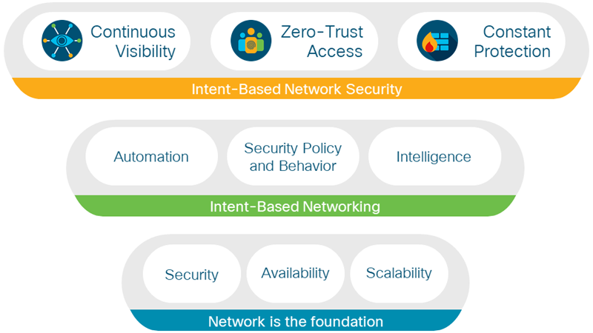
IT & Cloud Security Solutions
5G, cloud and virtualization is coming, our enterprise customers focus on comprehensive information security designing, consulting, implementation and deployment.

Slide 28
SD-WAN: Enterprise Network Transformation
IDT provides SD-WAN products to support corporate networks from dedicated VPN to the integration of different connection methods such as: 1. Physical leased line 2. Internet (ADSL / 4G / 5G) And provide routing / firewall function integration to reduce the cost of enterprise network equipment.

Slide 29
Core Business In the Future
Department | Market | Solution and Product
Telecom and Broadband | Strong demand on high-speed optical backbone in 5G era. …… | IP Transport / SDN / NFV/ Telecom Cloud/ AIoT / Big Data Analytics/ OSS/BSS 5G Transport /OTN / ROADM Optical Network………….
Mobile Network | IoT ultra high speed wireless and 5G procurement will increase in the next 3 years | 5G Base Station Implementation Mobile Network Optimization 5G Co-site Base Station Implementation
Media | UHD will be upgraded in broadcasters, cable operators and CHT MOD….. | 4K / UHD / Baseband over IP OTT applications AI in Media industry
IT & Cloud | For AI and IoT requirement, demand on cloud management and optimization, big data collection and analysis is increasing. | IT & cloud security solutions Integration of AI and IOT(integrates with Telcom 5G) …….
GIS | Spatio-temporal big data analytics in GIS integrated application | 3D GIS (GIS+BIM, 5G Site Analysis) DL / ML in GIS Spatial Big Data Science and Decision Support

Slide 30
GIS Business Strategy
Esri
-The global market leader in GIS.
-Widely used by every in different industries.
-Market share is over 50% in GIS.
-IDT is the Sole Distributor in Taiwan.
Major Industries and Customer Business Strategy
-Demand Generation Marketing
-Direct Sale by Deep Engagement with Consulting.
-Industry Domain Knowledge and Support Capacity.
Major Customers and Industries
Digital Sales and Partners Networks
Developers and Individuals Community

Slide 31
GIS Opportunities
Taiwan 3D Base Maps will support 3D GIS business development, to be used in natural resources, BIM and GIS integration, Telecom in 5G Site Planning.
IoT technology drives business value in real-time GIS.
Digital Twin (3D+IoT) plays key part of Smart City.
Spatial Analysis is an indispensable puzzle in Big Data Science.
The lately launched space program and drone technology will bring huge following image analytics opportunity for GIS.
The new opportunities raise up in Deep Learning and Machine Learning trained by Spatio-temporal Big Data.
Indoors GIS and Urban Planning.

Slide 32
GIS Strategy Map
Seamless Sale Experience
Partner Network
Developer and Individuals Communities
Deep Engagement in Major Market and Expand Emerging Market.
3D GIS and 5G Site Planning
Digital Twin in Smart City
Satellite and Drone Image Application
GeoAI
Operation
Opportunities
Research
Stength
GeoAI
GIS and BIM Integration
Field Survey in Electric Asset.
Using GIS in Smart Grid.
Cross Industries and Emerging Technologies Capacity.
Spatio-Temporal Business Value in Big Data and AI.

